Slide 1
Literature Survey on Temporal Graph Stores and Processing Presentation - 2
Shriram R
07-Jun-19

Slide 2
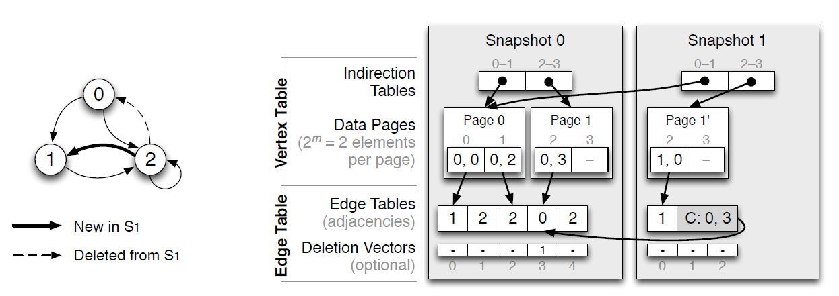
LLAMA: Efficient graph analytics using Large Multiversioned Arrays [1]
Uses augmented CSR representation and supports mutability and persistence
Multiple edge tables and single vertex table

Slide 3
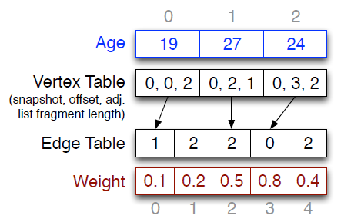
LLAMA: Efficient graph analytics using Large Multiversioned Arrays [1]
Supports vertex and edge properties
Supports merging of recent snapshots
Maintains a write-optimized delta map to buffer updates
Uses mmap for in-memory representation

Slide 4

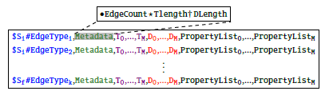
ZipG: A Memory-efficient Graph Store for Interactive Queries [2]
Distributed memory efficient graph store
Uses Succinct to compress data

Slide 5

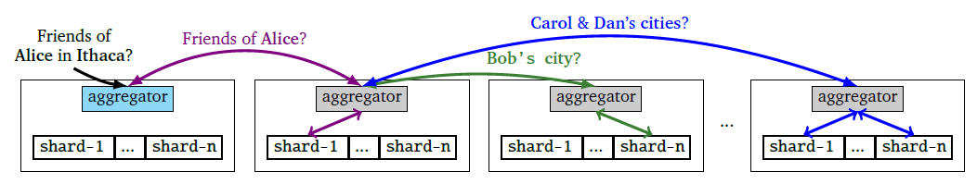
ZipG: A Memory-efficient Graph Store for Interactive Queries [2]

Slide 6

LEOPARD: Lightweight Edge Oriented Partitioning and Replication for Dynamic Graphs [3]
Supports continuous updates and adjusts the partitions dynamically
Implements replication in addition to partitioning and decreases overall edge cuts
Focus on work loads with read-only graph computations
Heuristic : When a vertex’s number of neighbors increases, the influence of a new neighbor decreases
the probability of performing reassignment examination after adding a new neighbor to v proportional to (1 − t)/(t)(v.neighbors)

Slide 7
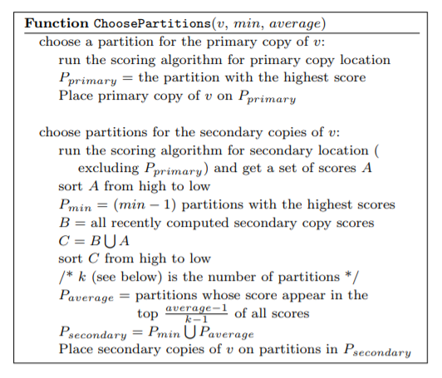
LEOPARD: Lightweight Edge Oriented Partitioning and Replication for Dynamic Graphs [3]
Replication Scheme : Minimum Average Replication (MAR)
Effective edge cut takes replication into consideration
Example: Min = 2 & Avg = 3
Sliding Window = 24, P = 5
Primary Scores: 0.15, 0.25, 0.35, 0.45, 0.55
Secondary Scores: 0.1, 0.2, 0.3, 0.4
4 scores are combined with 24 recent scores

Slide 8
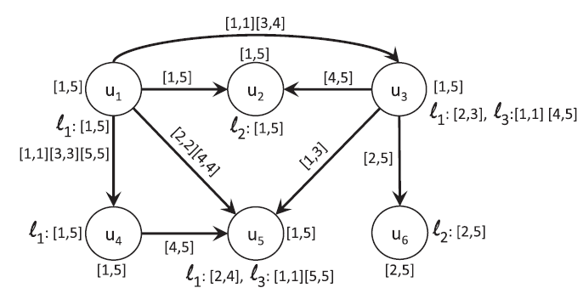
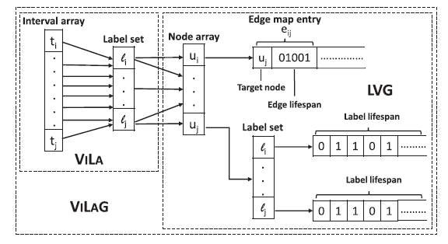
Top-k Durable Graph Pattern Queries on Temporal Graphs [4]
Finds subgraph matches that exist for longest period of time
Proposes compact representation of graph, time indexes & pruning strategies

Slide 9
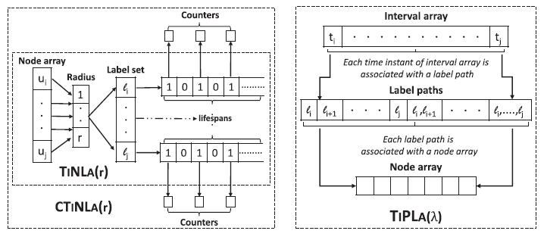
Top-k Durable Graph Pattern Queries on Temporal Graphs [4]

Slide 10
References
Macko, Peter, et al. "Llama: Efficient graph analytics using large multiversioned arrays." 2015 IEEE 31st International Conference on Data Engineering. IEEE, 2015.
Khandelwal, Anurag, et al. "Zipg: A memory-efficient graph store for interactive queries." Proceedings of the 2017 ACM International Conference on Management of Data. ACM, 2017.
Huang, Jiewen, and Daniel J. Abadi. "Leopard: Lightweight edge-oriented partitioning and replication for dynamic graphs." Proceedings of the VLDB Endowment 9.7 (2016): 540-551.
Semertzidis, Konstantinos, and Evaggelia Pitoura. "Top-$ k $ Durable Graph Pattern Queries on Temporal Graphs." IEEE Transactions on Knowledge and Data Engineering 31.1 (2018): 181-194.

